Slide 1
Calgary Local Immigration Partnership All CLIP Meeting February 2023

Slide 2
Agenda
Opening and land acknowledgement
CLIP update
Environmental scan and system map presentation by TIES
Table discussions
Lunch prioritization for CLIP priorities
Notes:
Muster point
Bathrooms

Slide 3
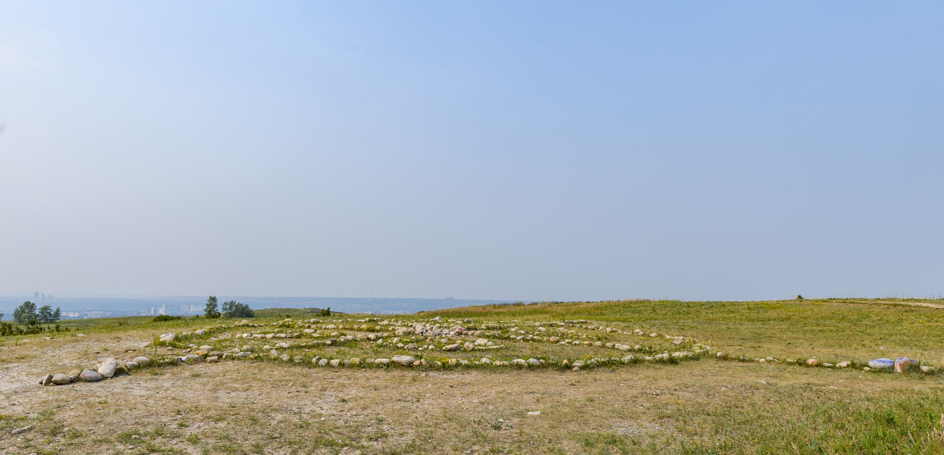
Land acknowledgment
Notes:
Nose Hill Siksikaitsitapi Medicine Wheel

Slide 4
2021 - 2022 highlights
Action teams
Refugees welcome here campaign
Newsletter and website
Data: LIP dashboard and Census data
Environmental scan – TIES
Governance review – Canadian Poverty Institute
Notes:
This is not at all a full list. Will only go into a few key highlights here. A final report will be shared in April.
Action teams: we had some incredible people join our action teams.
In August we recruited, in September the teams were onboarded and began their work. They just competed their work and many are looking to continue.
All were based on the action plans set by CLIP council.
Combating Racism action team.
the group looked into examples of successful hate crimes protocols.
We slowed down the work for Action Dignity to reviewing their work to ensure that any engagement we do isn’t anything we already asked. Why you haven’t heard anything is because we are meeting this week to discuss what's needed and next steps.
The goal of the protocol is to support a quick response when a hate crime or hate incident happens in the community with a united voice to condemn the act and to have shared recommendations for how to stop future events like that happening again. More to come.
Two Newcomer Mental Health and Wellness action teams
The united goal to identify ways to decrease barriers and improve access to newcomer health supports.
One group updated the list of Mental Health and wellness organizations, their contacts and the services that they provide. Work is underway to share this with you all.
The second is identifying research topics coming out to the mental Health and wellness conference and the recommendations of the LACE project.
More to come on our website and newsletter from this group.
2 Communications action team & heath info team
To look at better information sharing. But we did come into some capacity issues so this work is still ongoing. intent was for it to be a review of our communications work but didn’t go as planned.
Newcomer Education on Indigenous History action team
looked into the education materials/toolkits/resources that are available in our local community for educating newcomers on the impact of colonialization on Indigenous peoples in Canada.
The goal being amplify and/or improve upon already existing resources and supports and create supports where needed. We will also be connecting them into what others are doing across the country. This work is also still ongoing.
Refugees Welcome Here Campaign
CLIP hosted two successful events in the summer for the #RefugeesWelcomeHere Campaign.
This fall we partnered with MRU journalism class to feature the diversity of newcomers. These will be shared through our newsletter and social.
CLIP Communications
We continue to have above average ‘open rates’ with our 400+ subscribers.
CLIP continues to amplify the messages of our community partners through our social media channels and our own social media metrics are improving.
We will be working this year to update and streamline some of our work so watch for changes and easier sharing.
LIP Dashboard: The LIP dashboard was seamlessly transferred over to the national LIP
Reminder that 2021 Census Data is now live on Calgary.ca
An RFP was posted in June and awarded in August to TIES for the environmental scan and system map. Will share with you the highlights today. The full report will be on our website, our newsletter and emailed for sharing. The next steps for this will also be what could a community-based model to service delivery and funding look like in Calgary. We are just in the process of planning this based on the scan, and your conversation today and comprehensive engagement will take place this year so stay tuned for more info.
Finally we have a new governance structure that I will share with you now.

Slide 5
Governance review - what we did
Committee formed
CLIP Council and IAT reviewed options
Compared models against what success looks like as identified by the governance committee in 2021 and Collective Impact Criteria
Challenged ourselves to be transformative
Series of engagements
External consultant hired to review and provide options
Notes:
A lot went into the governance model review and so many people were involved. A full summary will be included in our year end.
-----
over the course of 2021-22, we started to talk about re-organization and reframing of how we work together.
First step: a sub-committee made up of members of the CLIP Council, the Immigrant Advisory Table and Working Groups.
That group lead the initiative and reported back and engage the Council, IAT and OOC at regular intervals.
A systems mapping exercise happened followed by a series of facilitated conversations with the United Way’s GAIN Team and Innovation Lab.
Second step: in August the Canadian poverty institute took all of that work, as well as past reports to provide a recommendation on a new model.
CLIP also reviewed all past governance conversations and pulled key needs, and objectives for Council and IAT review.
Council met 3 times to review, discuss, iterate on the models,
IAT provided feedback on the draft models.
In January they approved the model.
Next steps: to make the model operational.

Slide 6
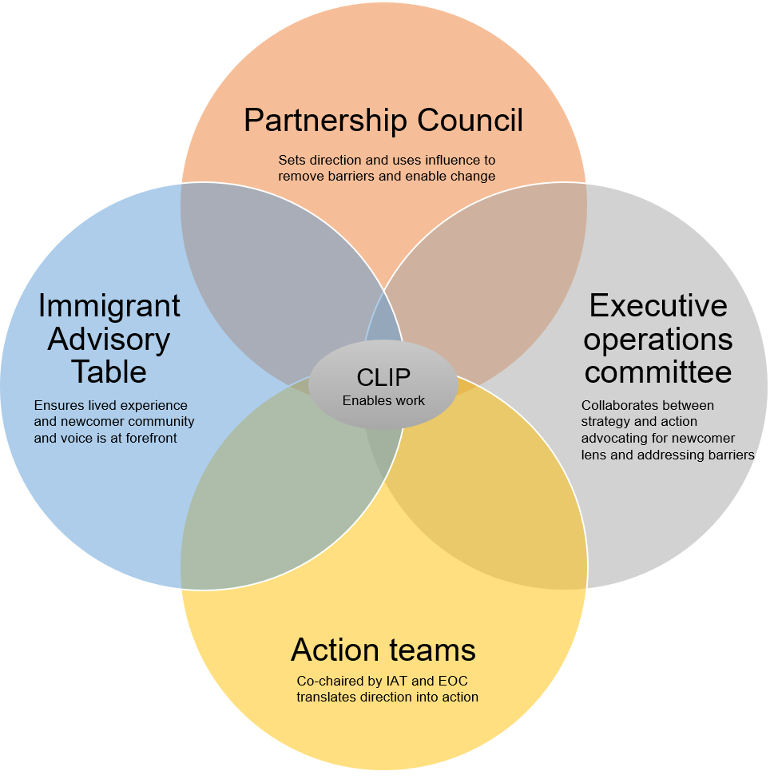
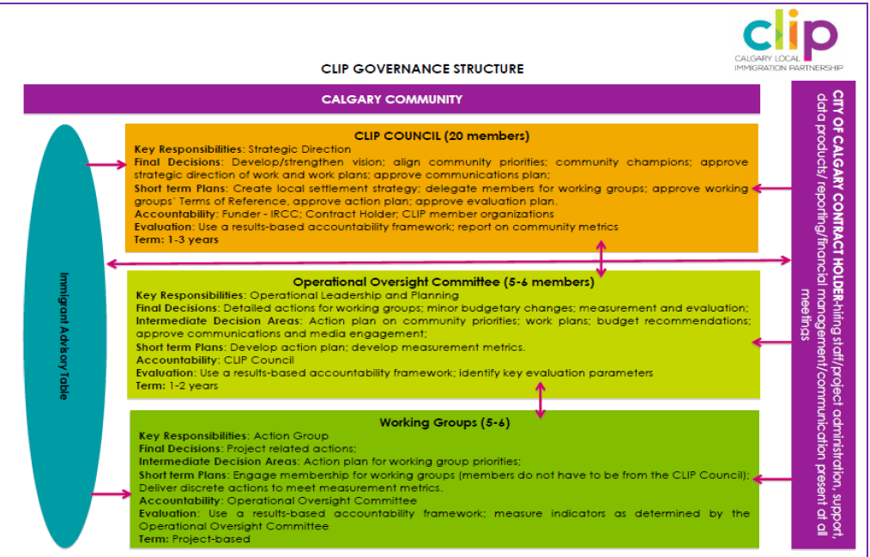
Governance review – new model
Notes:
Key changes: through line through the whole membership and connection to existing work.
Co-chairs from IAT will sit on partnership council
EOC made up of IAT and Partnership Council to be the problem solvers and connection to influence as well as knowledge action teams to be co-chaired by committee members for communications clarity and for issue identification

Slide 7
Governance review – next steps
Next step will be to create a structure to support the governance model.
Joint meeting of IAT and Council March 2023.
Model in effect April 2023.
Your feedback today to inform their action plan development.
Notes:
One piece of feedback that came up in all of the reviews and many conversations was that there was often a lack of clarity in role and responsibilities of each group.
Next step will be to create a structure to support the intent of the governance model

Slide 8
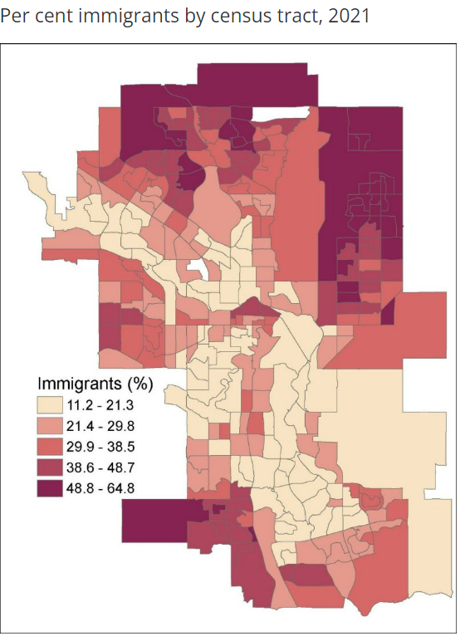
Why are we here?
33.3% the population were immigrants, up from 31 per cent in 2016.
Notes:
In Calgary in 2021 Together, first and second generation immigrants represent 6 out of 10 residents in Calgary in 2021. In other words, majority of Calgarians today are either first or second generation immigrants (98-316-X2021001).
We are all here with the same objective or mission, to create a great Calgary for all who come and live here. This is ongoing work and from you we need the issues, why they are important and who needs to be part of the work so that we can share it with clip council and so that they, along with the IAT and action teams, can create specific actions.
CLIP is made up of over 120 community partners. We are here to bring you together and to fill in systemic gaps to hopefully make it easier for you to do your work.
This is why:
Over the holiday we encouraged you to think over key trends/needs/gaps and some untapped opportunities, related to newcomer experiences in Calgary, that need a collective approach.
We also asked you to do some pre work this week.
We have divided the room in 4. by priority and on your table and will be some of the pre-work issues and ideas shared already.
For language we didn’t get any and some shared that it should not be a priority. For that space we will still keep it for you to discuss and have added systemic and sector collaboration ideas in that space.
This again will be shared with IAT and CLIP council and back with you all to make our next action plan.

Slide 9
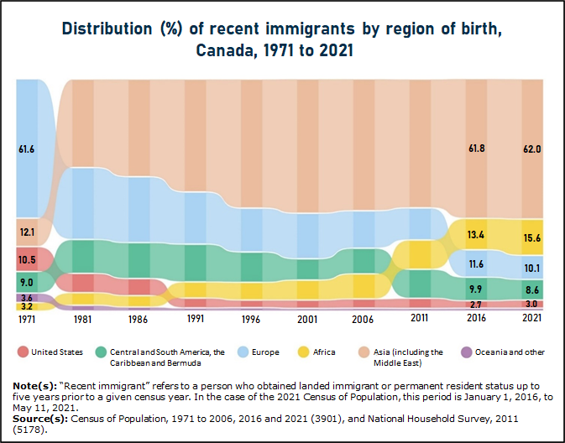
Immigration trends
Notes:
We know that immigration trends are changing. In the pre work isms, and particularly racism was shared and something we want you to think about across all 4 areas.

Slide 10
Whole system approach
The goal of a LIP is to support the development of community-based partnerships that build welcoming communities.
We do this by bringing you all together.
So that we can all work toward the result: Immigrants in Calgary have a high quality of life.
Notes:
LIPs work to engage various partners including employers, school boards, health centres and networks, boards of trade, levels of government, professional associations, ethnocultural and faith-based organizations, and the community and social service sectors to develop a local strategic plan that supports the settlement and integration of newcomers.
As you listen to the presentation from Ties think about a systemic approach to issues, who is impacted, who needs to be part of the conversation who is already doing the work for when you go into your discussions.
There is paper and post-its for you to take notes.
We are a full house with limited facilitation support today so please write things down, point form is fine but be specific.

Slide 11
Closing and next steps
Engage portal for final thoughts until Feb 20.
Feedback collated and shared with CLIP IAT and Council for action plan development.
Full report back in April.
Environmental scan full report to be shared with you.
Watch for invitations for our next set of engagement session for developing a community-based plan for Calgary.

